Slide 1
IBM-CIENCIA DE DATOS
Camila Rodríguez Jiménez

Slide 2
Outline
Executive Summary
Introduction
Methodology
Results
Conclusion

Slide 3
Executive Summary
Summary of methodologies
Data Collection through AP
Data Collection with Web Scraping
Data Wrangling
Exploratory Data Analysis with SQL
Exploratory Data Analysis with Data Visualization
Machine Learning Prediction
Summary of all results
Exploratory Data Analysis result
Interactive analytics in screenshots
Predictive Analytics result

Slide 4
Introduction
Project background and context
SpaceX advertises Falcon 9 rocket launches at a cost of 62 million dollars per launch, significantly lower than the 165 million dollars or more charged by other providers. A major contributor to these savings is the reusability of the first stage of the Falcon 9 rocket.
By predicting whether the first stage will land successfully, we can estimate the overall launch cost. This insight is valuable for alternate companies aiming to compete with SpaceX for rocket launch contracts.
The objective of this project is to develop a machine learning pipeline capable of predicting the successful landing of the first stage of a Falcon 9 rocket.
Problems you want to find answers
What factors determine if the rocket will land successfully?
The interaction amongst various features that determine the success rate of a successful landing.
What operating conditions needs to be in place to ensure a successful landing program.

Slide 5
Methodology
Executive Summary
Data collection methodology:
Describe how data was collected
Perform data wrangling
Describe how data was processed
Perform exploratory data analysis (EDA) using visualization and SQL
Perform interactive visual analytics using Folium and Plotly Dash
Perform predictive analysis using classification models
How to build, tune, evaluate classification models

Slide 6
Data Collection
The project data was gathered using two primary methods:
SpaceX API
Data was retrieved via HTTP GET requests and parsed from JSON format into a structured pandas DataFrame using .json_normalize().
Missing values and inconsistencies were cleaned and handled to ensure quality.
Web Scraping
Additional launch records were scraped from Wikipedia using BeautifulSoup.
HTML tables were extracted, parsed, and converted into pandas DataFrames for analysis.
The final dataset combines both sources, forming a clean and unified foundation for analysis and
modeling.

Slide 7
Data Collection – SpaceX API
Data Retrieval:
Utilized an HTTP GET request to query the SpaceX REST API.
Perform GET to SpaceX API
Receive JSON response
Convert JSON to
DataFrame
Data Cleanup
Result: Clean and
structured DataFrame
Collected launch data, performed basic wrangling and applied data formatting to structure the response.
Data Processing:
Transformed the JSON response into a pandas DataFrame for further analysis.
Performed data cleaning to handle missing or inconsistent values.
External Reference:
For full implementation and output, refer to the completed notebook on GitHub: SpaceX API Data Collection Notebook

Slide 8


Data Collection - Scraping
Web Scrape Process:
Used HTTP GET requests to retrieve Falcon 9 launch records from a Wikipedia page.
Leveraged BeautifulSoup to parse the HTML content and extract the launch table.
GET to Wikipedia page
Extract HTML content
Parse HTML with BeautifulSoup
Extract table of releases
Convert table to
DataFrame
Result: Data ready
Data Transformation:
Extracted the launch table and converted it into a pandas DataFrame for analysis.
External Reference:
The full implementation, including code and results, can be accessed here:
Web Scraping Notebook on GitHub

Slide 9
Data Wrangling
Key Steps of Data Wrangling Process:
Exploratory Data Analysis (EDA): Identified
Exploratory Data Analysis (EDA)
Calculate metrics by site/orbit
Create landing tags
Export results to
CSV
patterns and key insights in the dataset.
Key Metrics Summary: Calculated launches per
site and occurrences of orbit types.
Outcome Label Creation: Created landing
outcome labels from the Outcome column.
Export Process: Saved the cleaned and transformed data as a CSV file for further analysis.
External Reference:
For full implementation and outputs, refer to: GitHub Notebook - Data Wrangling

Slide 10
EDA with Data Visualization
Charts and Purpose
Flight Number vs Launch Site: Understand the relationship between flights and launch sites (Cat plot).
Payload Mass vs Launch Site: Analyze payload mass variations and mission success (Scatter plot).
Success Rate by Orbit Type: Determine orbit types with higher success rates (Bar chart).
Flight Number vs Orbit Type: Identify flight distribution and success rates by orbit (Scatter plot).
Payload Mass vs Orbit Type: Study payload mass across orbit types (Scatter plot with colors).
Yearly Trend of Launch Success: Observe trends in launch success over time (Line chart).
External Reference
GitHub Notebook - EDA with Data Visualization

Slide 11
EDA with SQL
Key SQL Queries
Unique Launch Sites: Retrieve distinct launch site names
Filtered Records: Launch sites starting with 'CCA’.
Payload Analysis:
Total payload mass for NASA (CRS).
Average payload mass for 'F9 v1.1' rockets.
Landing Outcomes
First successful ground landing date.
Count of successful and failed landings.
Performance Analysis
Boosters with maximum payload.
Drone landings with payload between 4000–
6000 kg.
Failed drone landings in 2015.
External Reference
The complete notebook can be accessed here:
EDA with SQL Notebook on GitHub

Slide 12
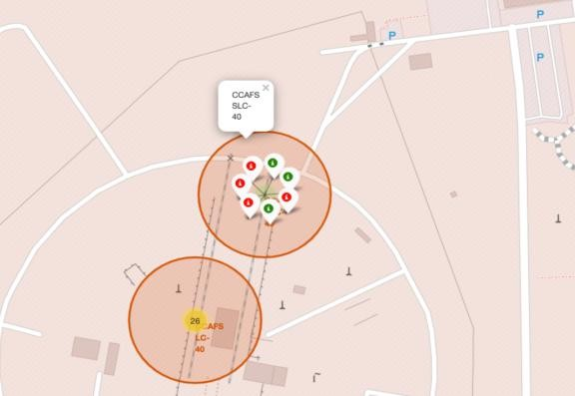
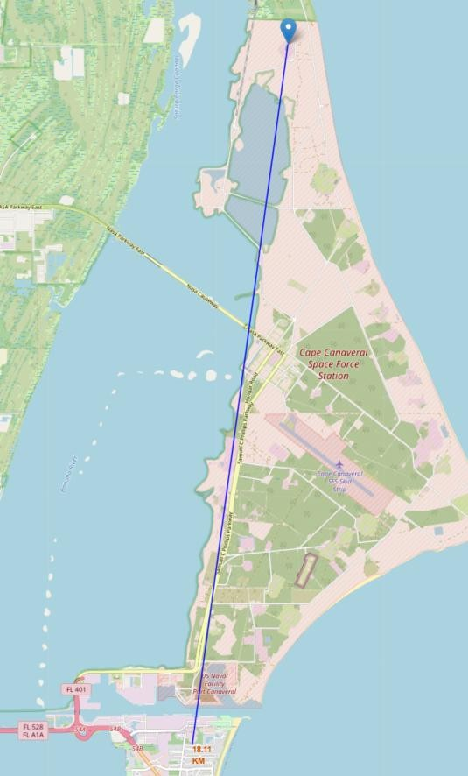
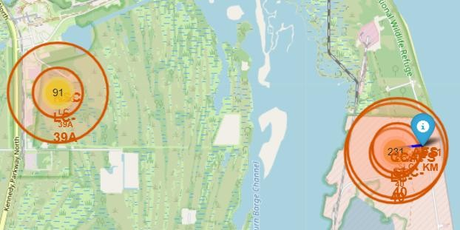
Build an Interactive Map with Folium
Markers: Indicate key points such as launch sites and display success or failure outcomes using color-coded markers (green for success, red for failure).
Circles: Highlight specific areas, such as launch site locations, for better visualization of geographic positions.
Marker Clusters: Group multiple markers at the same coordinates, such as multiple launches at a single site, to simplify the map.
Lines: Represent distances between launch sites and nearby coastal points, helping analyze proximity and location relationships.
External Reference: GitHub Link

Slide 13
Build a Dashboard with Plotly Dash
Pie Charts: Display the total number of launches by specific launch sites to visualize
launch frequency and site activity.
Scatter Plot: Illustrates the relationship between Outcome (success/failure) and Payload Mass (Kg) for different booster versions, helping identify patterns or trends in payload performance.
Interactions: The dashboard allows interactive exploration of the data, enabling users to filter by launch sites, booster versions, or payload mass ranges for deeper insights.
External Reference: GitHub Link

Slide 14


Predictive Analysis (Classification)
Data Preparation:
Extracted the target variable Class and standardized the features X using StandardScaler.
Data Preparation
Data Splitting
Model Training
Hyperparameter Tuning
Evaluation
Best Model Selection
Data Splitting:
Split data into training and testing sets (80/20) using train_test_split.
Model Training and Hyperparameter Tuning:
Logistic Regression: Tuned C, penalty, and solver (accuracy: 84.6%).
SVM: Tuned kernel, C, and gamma (accuracy: 84.8%).
Decision Tree: Optimized criterion, max_depth, and min_samples_leaf (accuracy: 77.8%).
KNN: Tuned n_neighbors, algorithm, and p (accuracy: 84.8%).
Model Evaluation:
Confusion matrices and test accuracy scores were analyzed to evaluate model performance.
Best Performing Model:
Logistic Regression provided the best balance of accuracy at 83%.
External Reference: GitHub Link

Slide 15
Results
Exploratory Data Analysis (EDA) Results:
Insights from the dataset were derived using visualizations and statistics, highlighting key patterns and trends.
Interactive Analytics Demo:
Screenshots showcase interactive plots and graphs developed for dynamic exploration of data relationships.
Predictive Analysis Results:
Performance of models: Logistic Regression, SVM, Decision Tree, and KNN.
Confusion matrices and accuracy scores were analyzed.
Logistic Regression provided the best balance with 83% accuracy

Slide 16
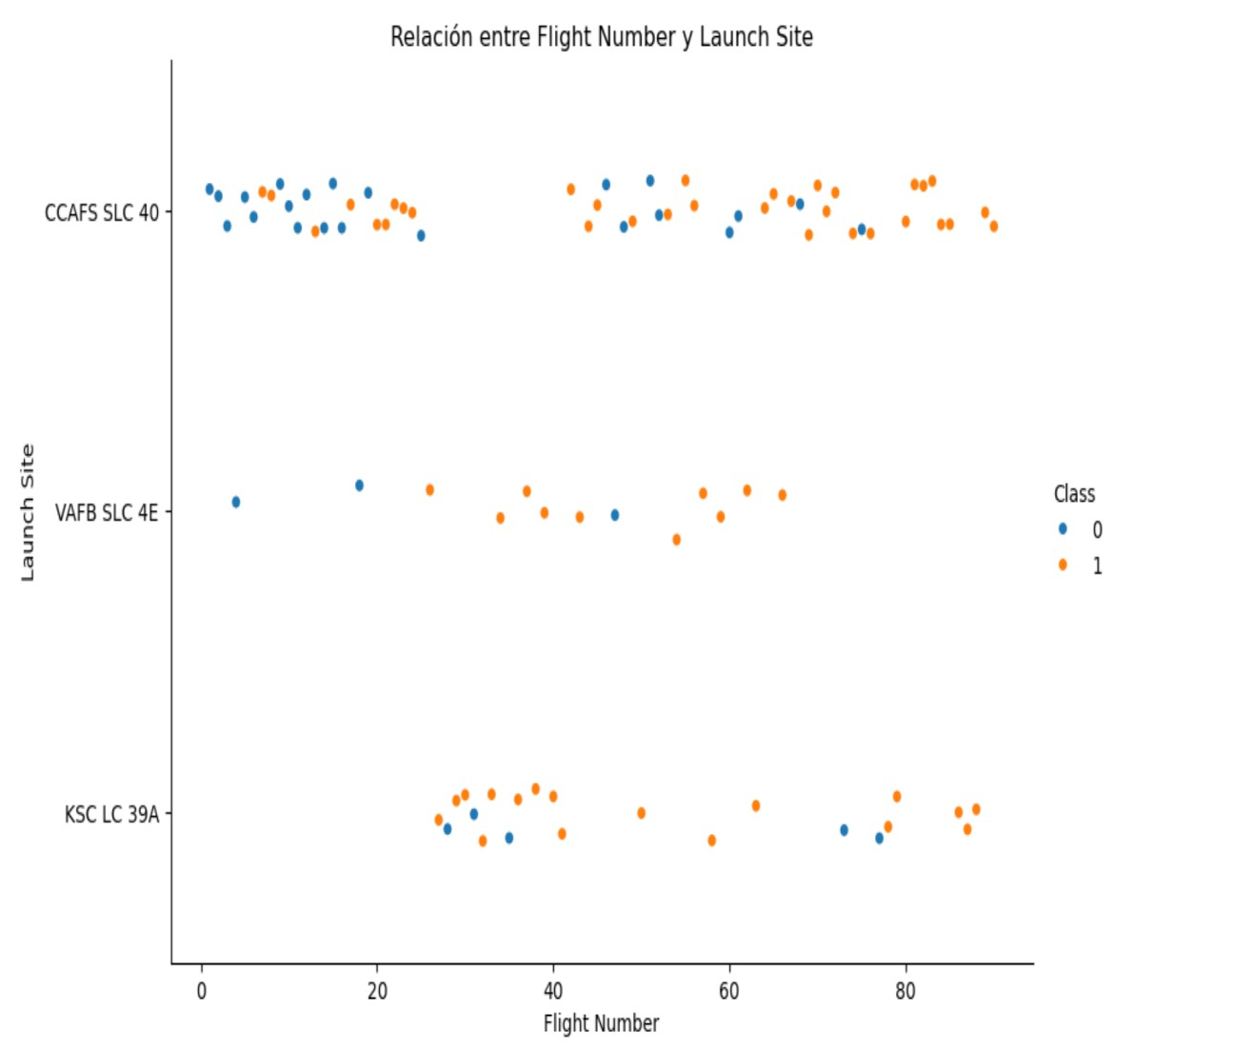
Flight Number vs. Launch Site
Graph Explanation:
The scatter plot shows the relationship
between Flight Number and Launch Site.
Key Insight:
From the plot, it can be observed that the higher the number of flights at a launch site, the greater the success rate.
For example, sites with more flight numbers, such as CCAFS SLC 40 and KSC LC 39A, have a higher concentration of successful launches (represented in orange).
This suggests that experience and operational frequency at a launch site positively impact the likelihood of launch success.

Slide 17
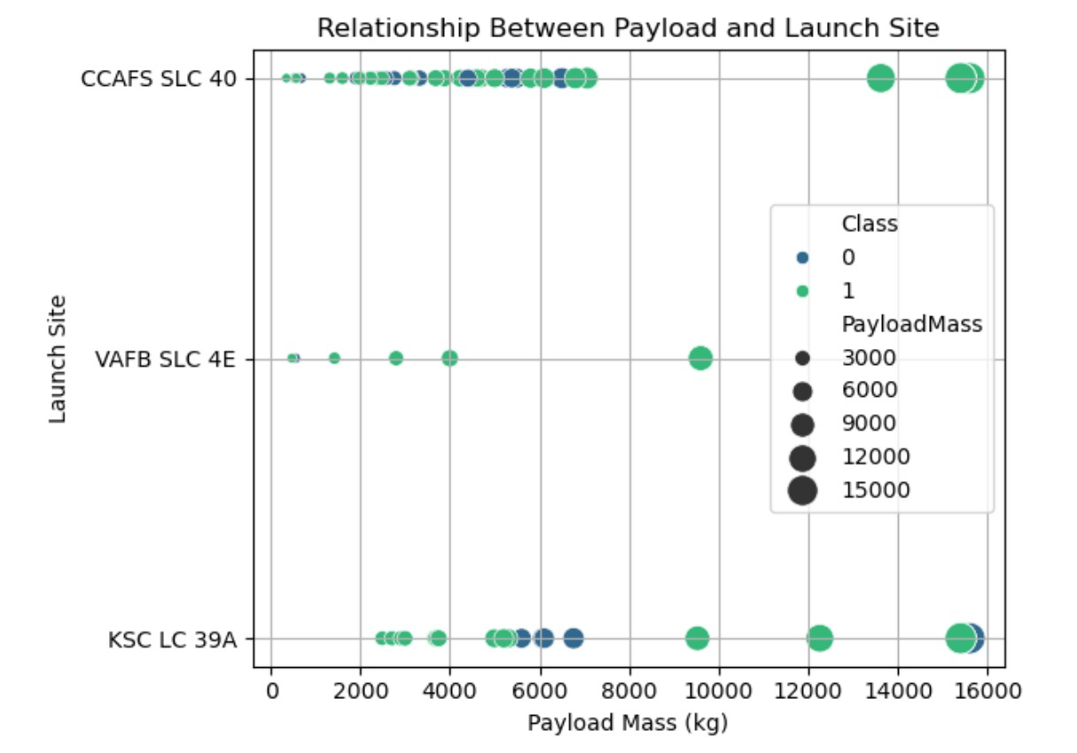
Payload vs. Launch Site
Graph Explanation:
The scatter plot visualizes the relationship
between Payload Mass (kg) and Launch Site.
Key Insight:
From the plot, it is evident that heavier payloads tend to be associated with higher success rates (green points representing successful launches).
Launch sites like KSC LC 39A and CCAFS SLC
40 can accommodate heavier payloads, and these sites have a higher success rate for payloads up to 15,000 kg.
VAFB SLC 4E shows limited launches with
relatively lower payload mass.
This indicates that the payload capacity at certain launch sites influences success outcomes.

Slide 18
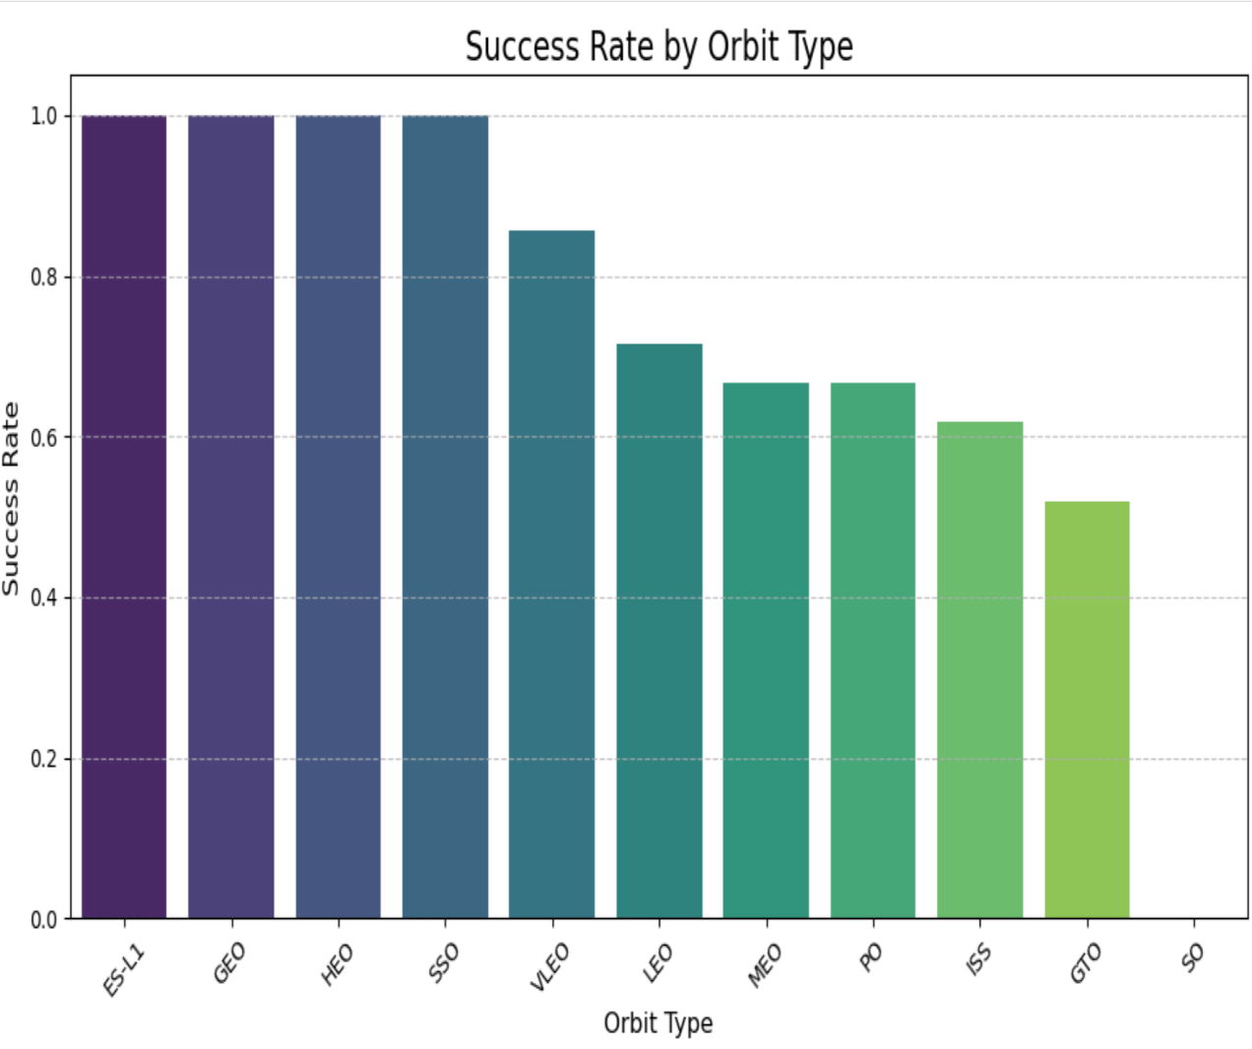
Success Rate vs. Orbit Type
Graph Explanation:
The bar chart shows the success rate for different orbit types.
Key Insights:
ES-L1, GEO, HEO, and SSO have a 100% success rate.
VLEO and LEO also show high success rates above 80%.
GTO has the lowest success rate (~50%), highlighting challenges for this orbit.

Slide 19
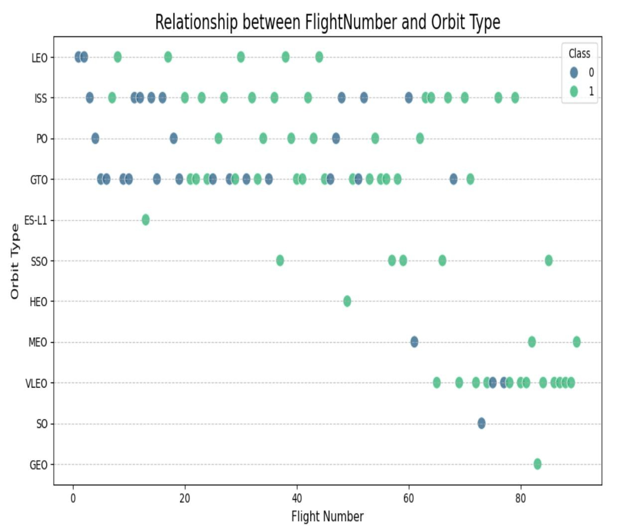
Flight Number vs. Orbit Type
Graph Explanation:
The scatter plot shows the relationship between Flight Number and Orbit Type. Each point represents a flight, with the success class indicated by color:
Green: Success (Class = 1)
Blue: Failure (Class = 0)
Key Insights:
Higher flight numbers are linked to increased success rates, especially in LEO and ISS orbits.
GTO orbit shows mixed outcomes, reflecting greater challenges.

Slide 20
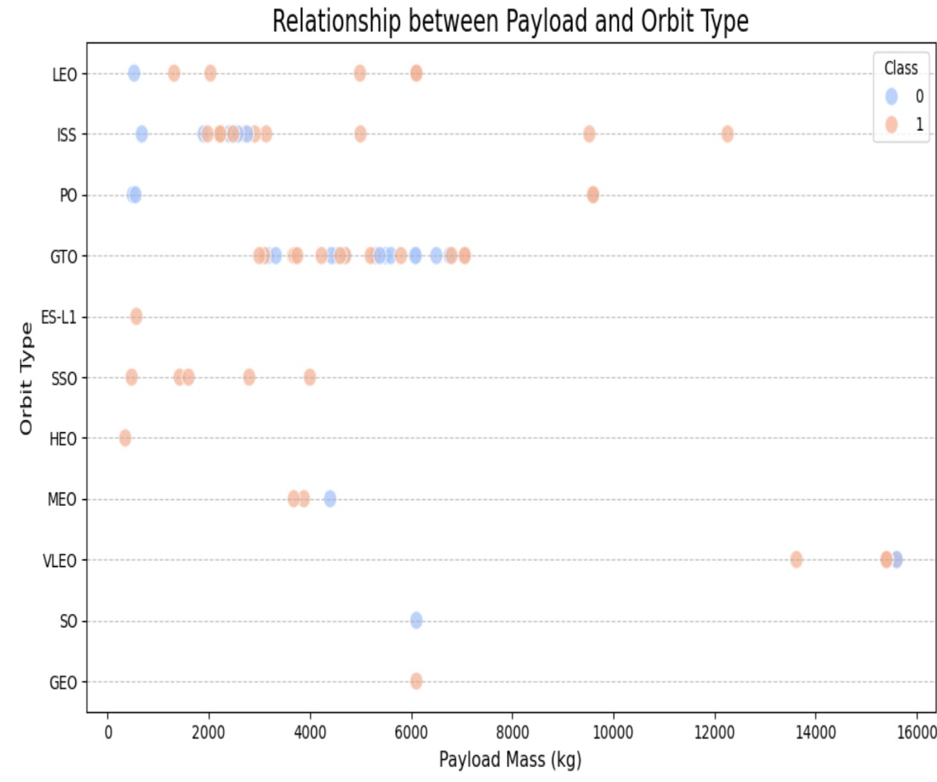
Payload vs. Orbit Type
Graph Explanation:
The scatter plot shows the relationship between Payload Mass and Orbit Type. Successes (Class 1) are in orange, and failures (Class 0) in blue.
Key Insights:
LEO supports a wide payload range with higher success rates.
GTO has mixed results, especially with
heavier payloads.
Lower payloads generally show higher success across all orbit types.

Slide 21
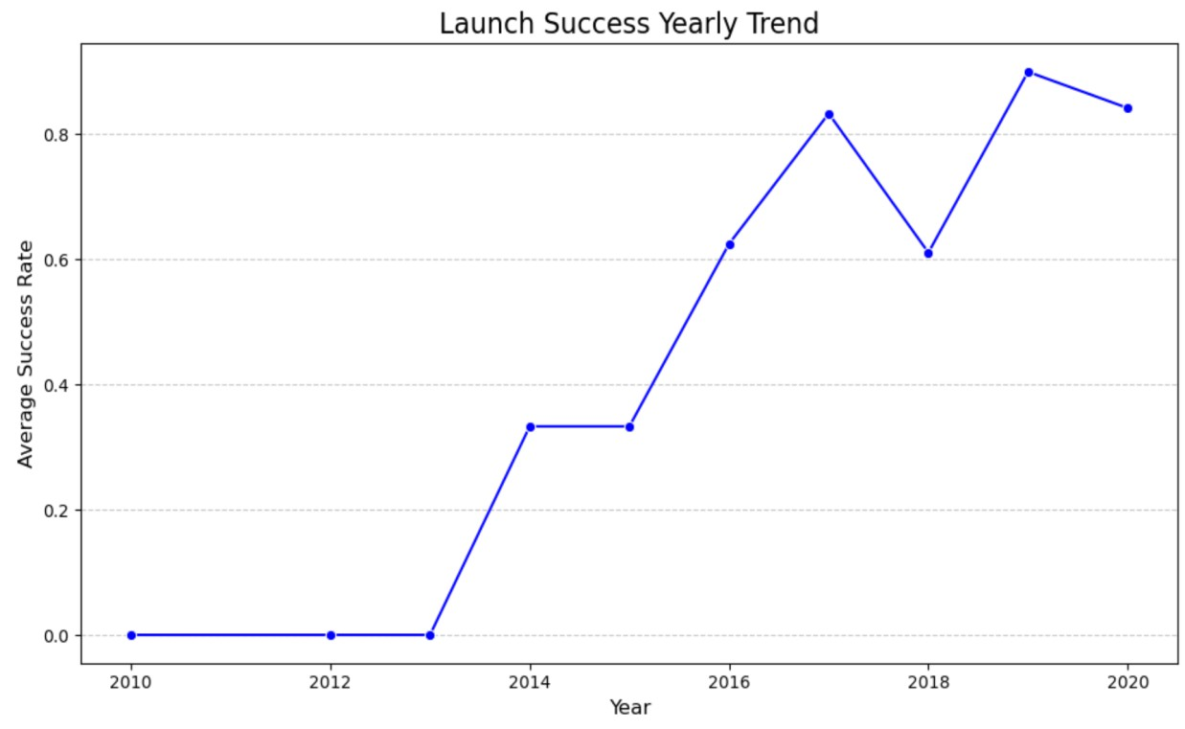
Launch Success Yearly Trend
Graph Explanation:
This line chart illustrates the yearly average success rate of launches over time, showing how success has improved significantly.
Key Insights:
Between 2010 and 2013, success rates were consistently low.
From 2014 onward, there was a steady upward trend, reflecting advancements in technology and processes.
By 2019, the success rate reached its peak, indicating significant reliability improvements in launch operations.
Although there is a slight drop in 2020, the overall trend remains positive.

Slide 22
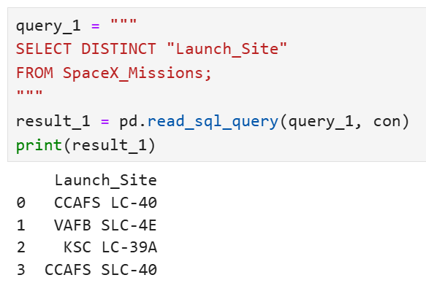
All Launch Site Names
SQL Query Explanation:
The query uses the DISTINCT keyword to retrieve only the unique launch site names from the SpaceX_Missions table. This avoids duplicate entries in the result.
Query Result:
The unique launch sites identified are:
CCAFS LC-40
VAFB SLC-4E
KSC LC-39A
Key Insight:
These launch sites represent the primary locations where SpaceX missions have been conducted.

Slide 23
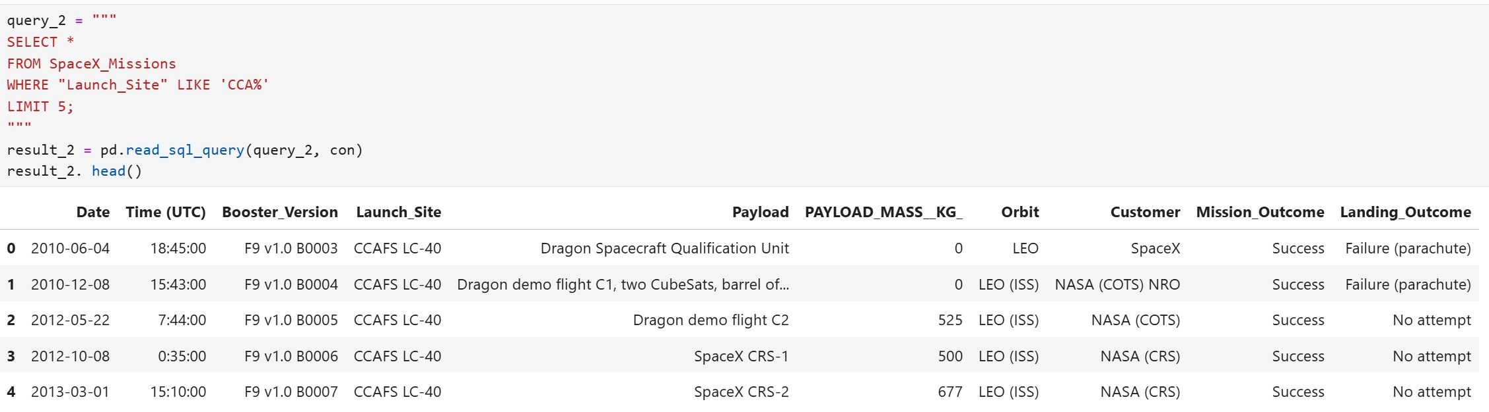
Launch Site Names Begin with 'CCA'
Query Explanation:
We used the LIKE operator with 'CCA%' to find 5 launch site records starting with 'CCA', limiting the results to the first 5 rows.
Results:
All records belong to the CCAFS LC-40 launch site, showing details like Date, Payload, Orbit, and Mission Outcome.

Slide 24
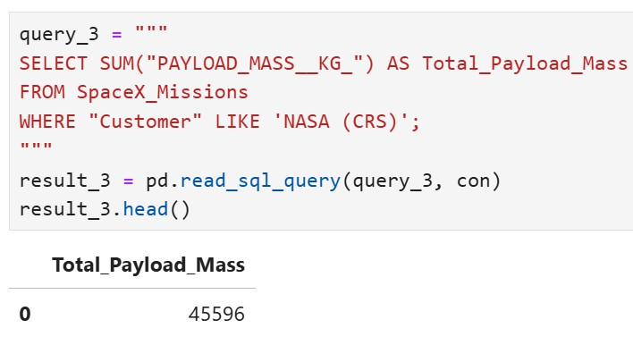
Total Payload Mass
We used the SUM function to calculate the total payload mass for missions where the customer is NASA (CRS). The total payload carried by boosters is 45,596 kg, as shown in the query result.

Slide 25
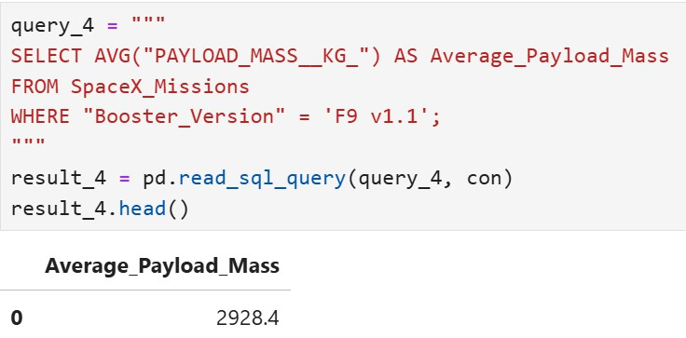
Average Payload Mass by F9 v1.1
We used the AVG function to calculate the average payload mass for missions where the booster version is F9 v1.1. The result is 2928.4 kg, as shown in the query result.

Slide 26
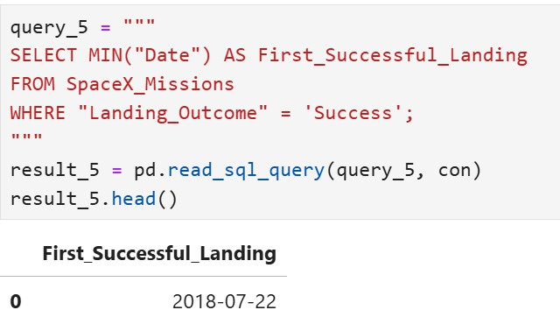
First Successful Ground Landing Date
We used the MIN function to find the earliest date where the Landing Outcome was a Success. The first successful landing outcome occurred on July 22, 2018, as shown in the query result

Slide 27
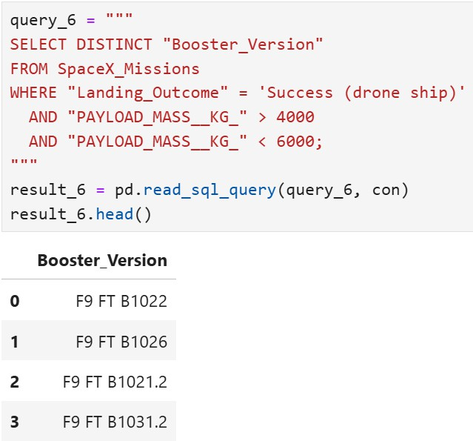
Successful Drone Ship Landing with Payload between 4000 and 6000
We applied a WHERE clause to filter for boosters with successful drone ship landings and used the AND condition to restrict the payload mass between 4000 kg and 6000 kg. The query returned the following booster versions:
F9 FT B1022
F9 FT B1026
F9 FT B1021.2
F9 FT B1031.2

Slide 28
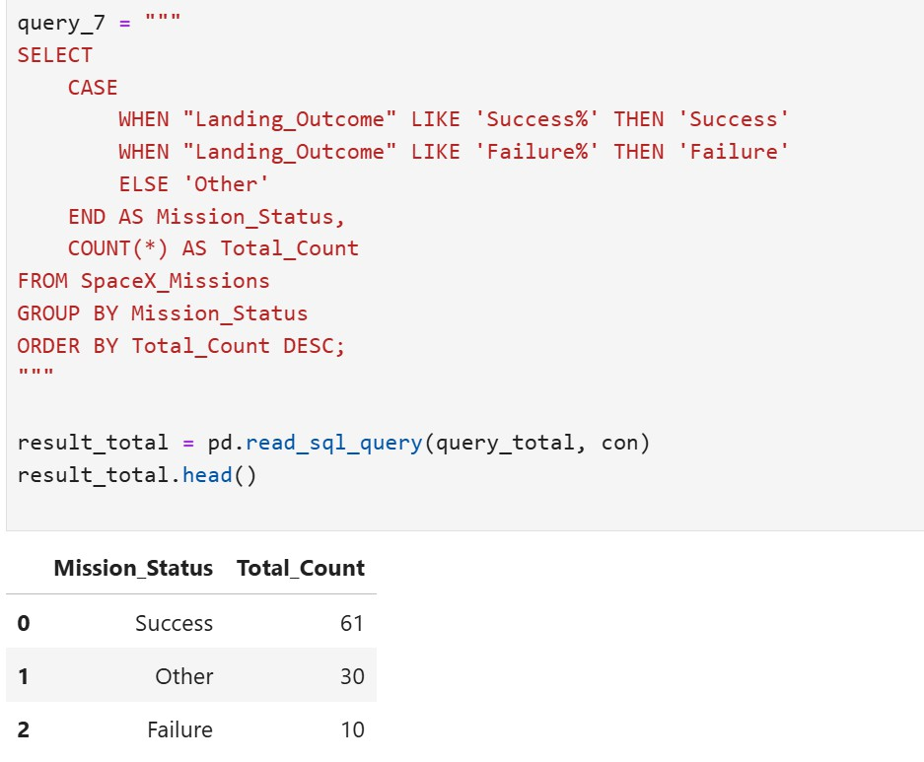
Total Number of Successful and Failure Mission Outcomes
We calculated the total number of successful and failed mission outcomes. Out of all missions, there were 61 successes and 10 failures, as shown below.

Slide 29
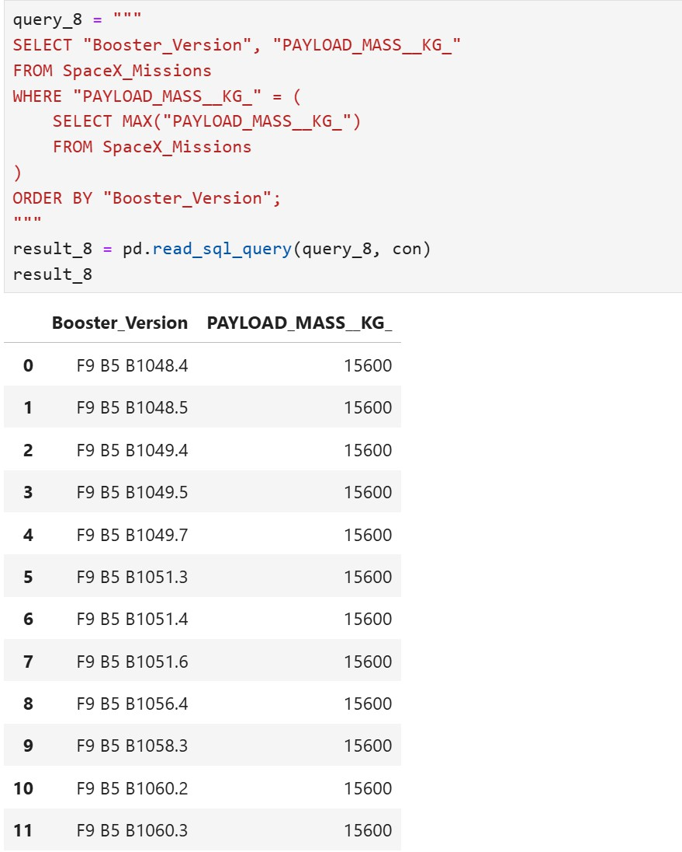
Boosters Carried Maximum Payload
We identified the booster versions that carried the maximum payload mass of 15,600 kg using a subquery. The query compares the payload mass of each record to the maximum payload mass in the dataset and retrieves the relevant booster names. The boosters that achieved this are listed below

Slide 30
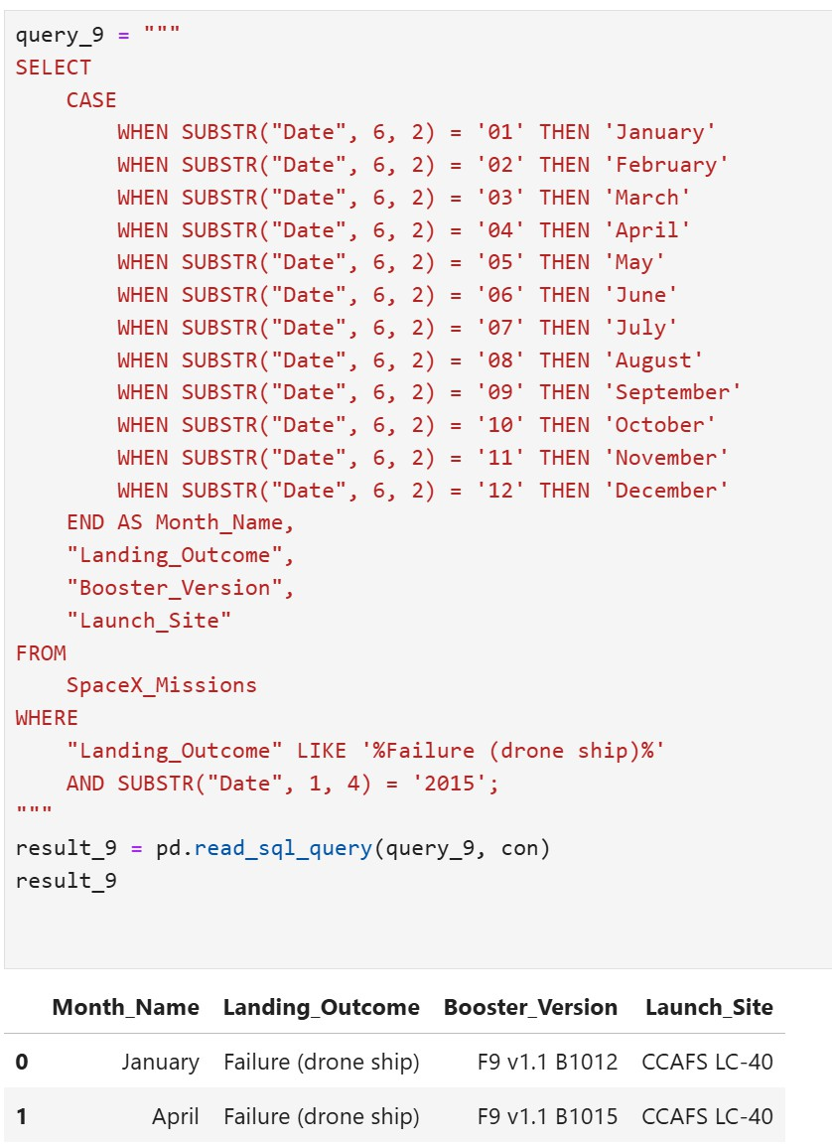
2015 Launch Records
We retrieved the records of failed drone ship landings in 2015. The query uses the SUBSTR function to extract the month and year from the date and classify them into their respective month names. The records show two failed landings in January and April at the CCAFS LC-40 launch site, as summarized below

Slide 31
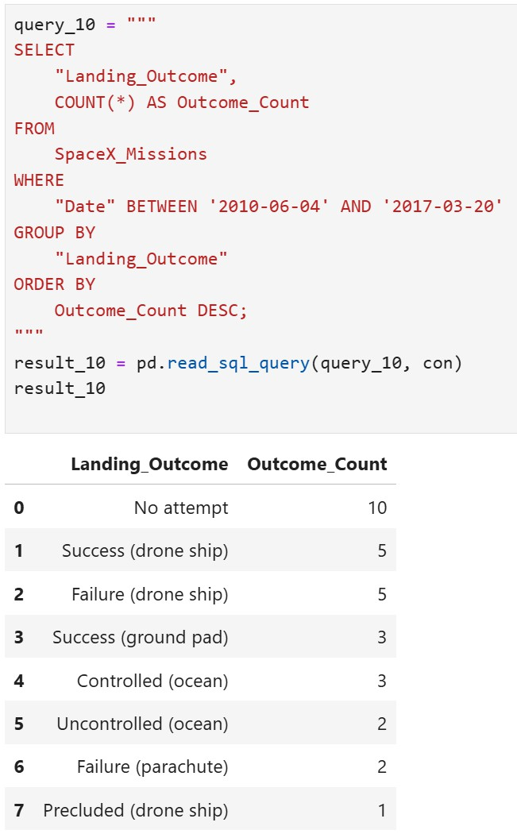
Rank Landing Outcomes Between 2010-06-04 and 2017-03-20
We retrieved the Landing Outcomes and their
corresponding counts from the dataset.
The WHERE clause was used to filter records between 2010- 06-04 and 2017-03-20.
The GROUP BY clause grouped the data by landing outcome.
The ORDER BY clause sorted the landing outcomes in descending order of their counts.
This approach provided a clear ranking of the different landing outcomes within the specified date range.

Slide 32
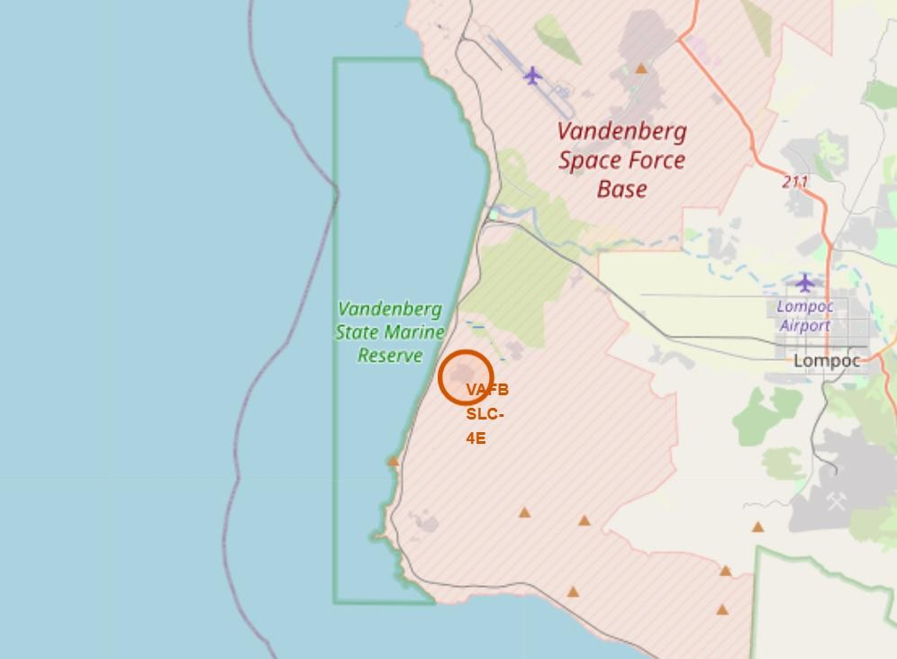
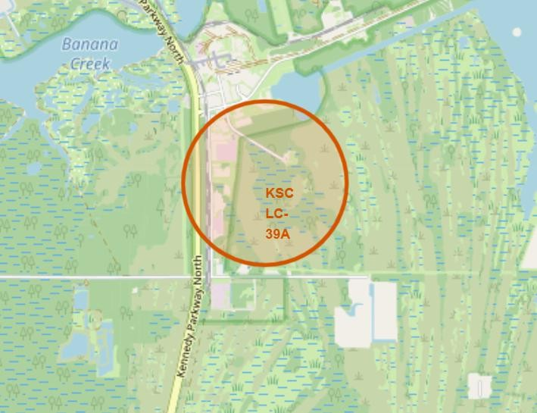
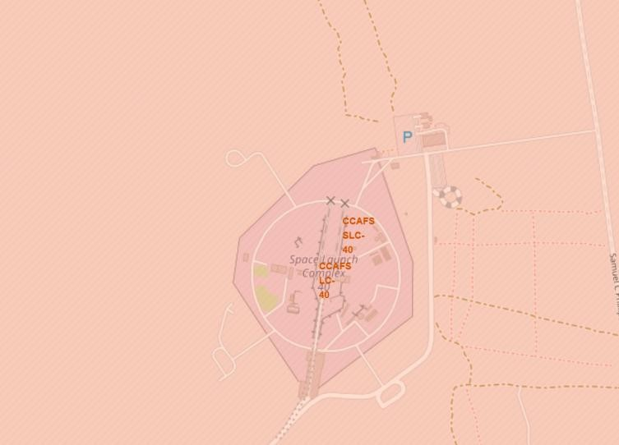
SpaceX Launch Site Locations in the United States
The map displays the locations of SpaceX launch sites in the United States:
VAFB SLC-4E (Vandenberg, California)
KSC LC-39A (Kennedy Space Center, Florida)
CCAFS LC-40 (Cape Canaveral, Florida).
These sites are strategically located to support various launch missions due to their geographic positioning and technical capabilities.

Slide 33
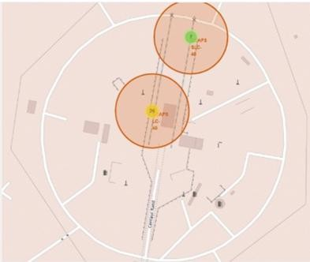
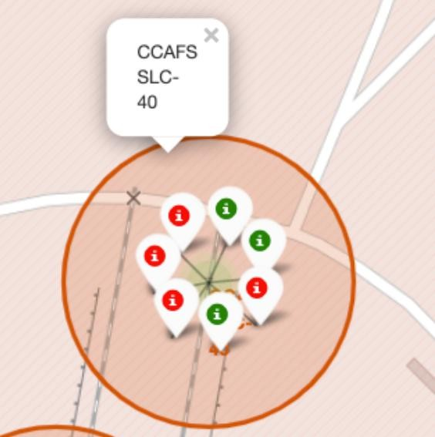
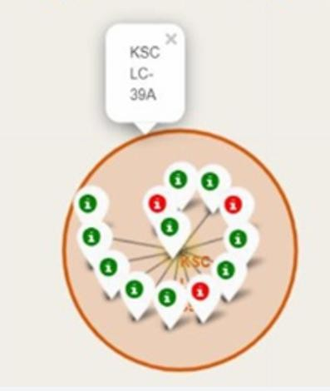
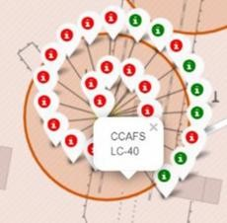
SpaceX Launch Outcomes: Successes and Failures by Site
The map shows SpaceX launch outcomes using color-coded markers:
Green for successful launches.
Red for failed launches.
Florida Launch Sites (CCAFS LC-40, KSC LC-39A) show a mix of successes and failures with dense activity.
California Launch Site (VAFB SLC-4E) also has both outcomes but fewer launches.

Slide 34
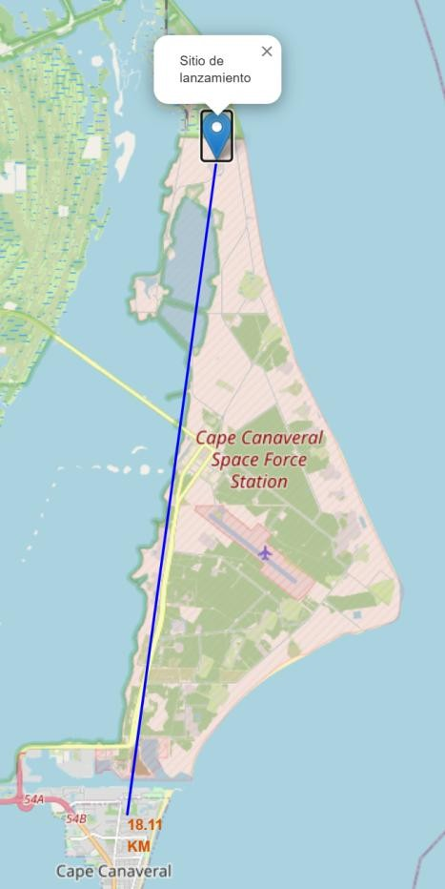
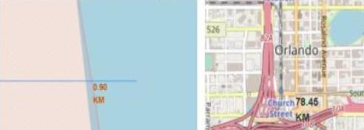
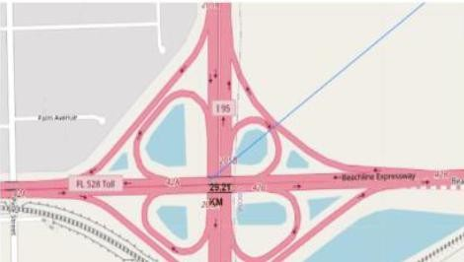
Launch Site Proximity Analysis: Cape Canaveral
The map highlights Cape Canaveral Space Force Station and its proximities:
Railway and highway networks are displayed for logistical access.
Coastline proximity shows launch sites’ strategic
placement near the ocean.
Measured distances include:
18.11 KM to Cape Canaveral.
0.90 KM to the coastline.
Key intersections near FL 528 Toll and I-95
highway.
Key Findings:
The location offers optimal connectivity to transportation networks and the coastline, enabling efficient logistics for launches and safety during takeoffs.

Slide 35
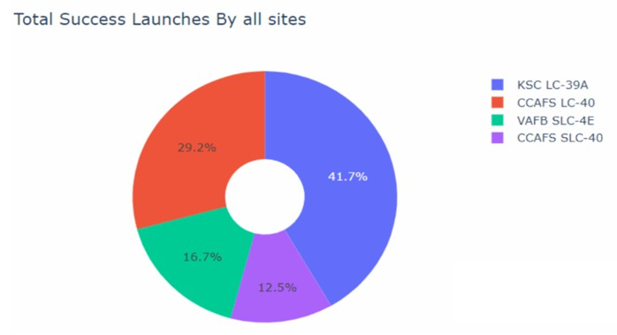
Launch Success Distribution Across All Sites
The pie chart illustrates the distribution of
successful launches across SpaceX's launch sites:
KSC LC-39A (Blue): 41.7% of total successful launches, the highest contribution.
CCAFS LC-40 (Red): 29.2% of successful launches.
VAFB SLC-4E (Green): 16.7% of successful launches.
CCAFS SLC-40 (Purple): 12.5% of successful launches.
Key Findings:
KSC LC-39A plays a dominant role in successful launches, contributing nearly half of the total.

Slide 36
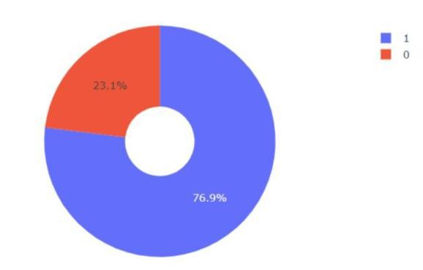
KSC LC-39A: Launch Success and Failure Ratio
The pie chart represents the success and failure rates for the launch site KSC LC-39A, which achieved the highest launch success ratio among all SpaceX launch sites.
Key Findings:
Success Rate (Blue): 76.9% of launches were successful.
Failure Rate (Red): 23.1% of launches resulted in failure.
This highlights KSC LC-39A's consistent performance as the leading site for successful missions, reinforcing its strategic importance in SpaceX's operations.

Slide 37
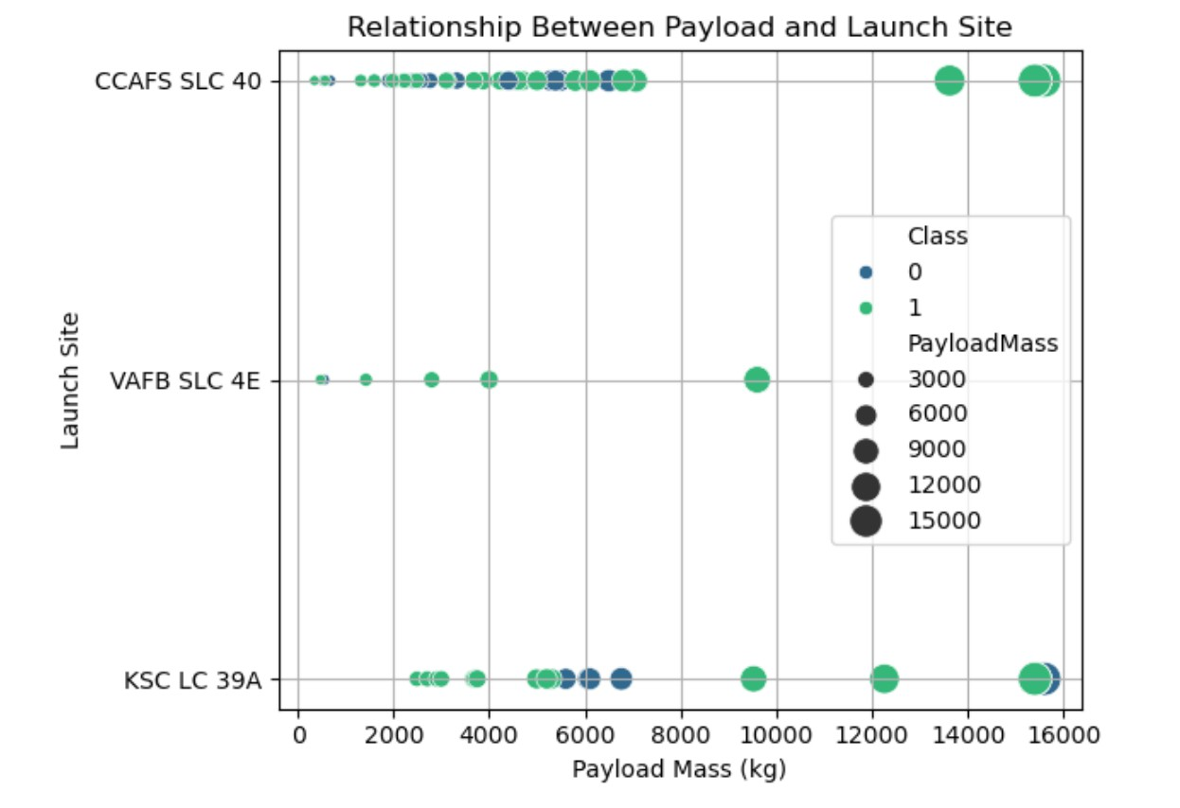
Payload vs. Launch Outcome Across All Sites
The scatter plot illustrates the relationship between payload mass (kg) and launch outcomes at three launch sites: CCAFS SLC-40, VAFB SLC-4E, and KSC LC-39A.
Key Findings:
Green markers indicate successful launches; blue markers indicate
failures.
CCAFS SLC-40 managed the largest payloads (up to 16,000 kg) with a high success rate.
VAFB SLC-4E shows successes for payloads under 10,000 kg.
KSC LC-39A has mixed results for payloads between 6,000 kg and
16,000 kg.
The analysis highlights CCAFS SLC-40's superior performance, particularly for heavier payloads.

Slide 38
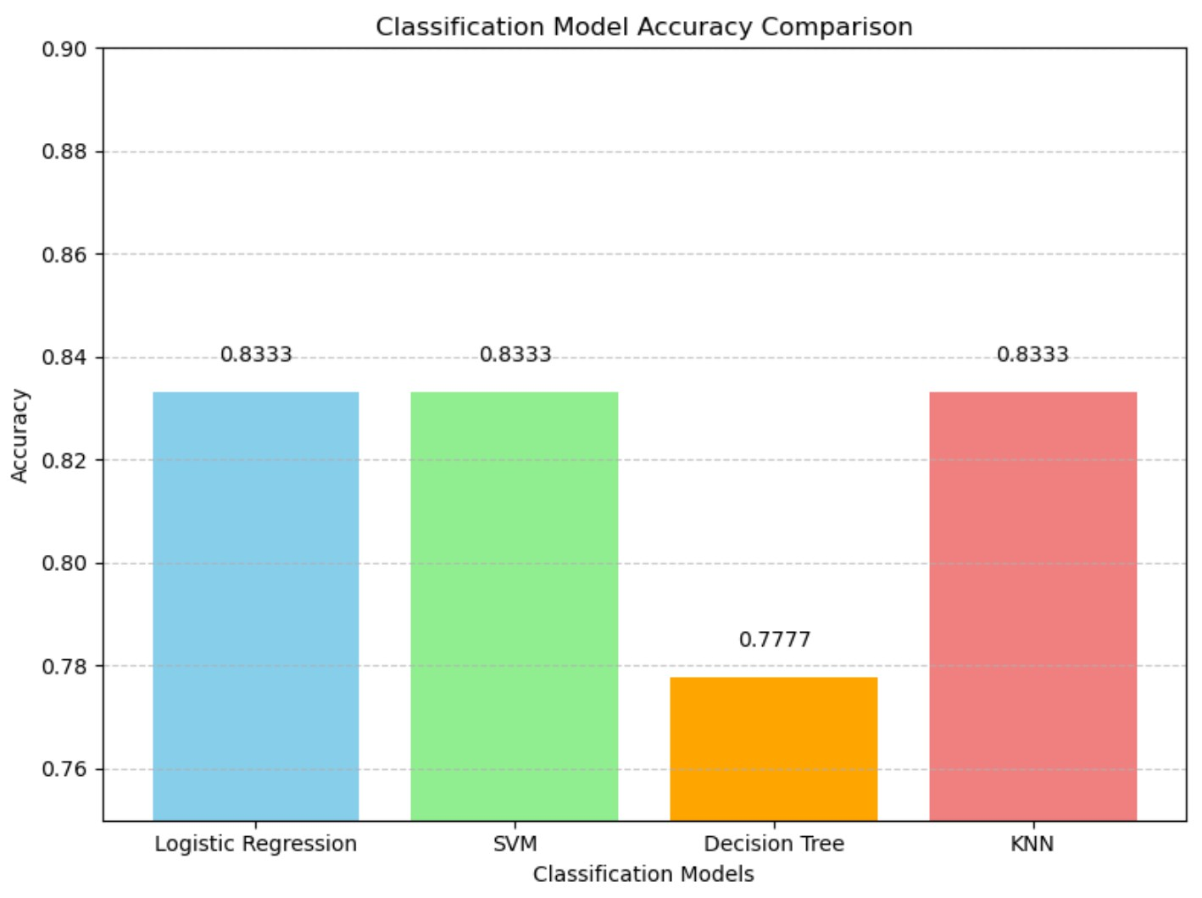
Classification Accuracy
The bar chart compares the accuracy of the built classification models:
Logistic Regression, SVM, and KNN achieved the highest accuracy of 83.33%.
The Decision Tree model had the lowest accuracy at 77.77%.
Key Findings:
Logistic Regression, SVM, and KNN performed equally
well, while Decision Tree showed lower accuracy.

Slide 39
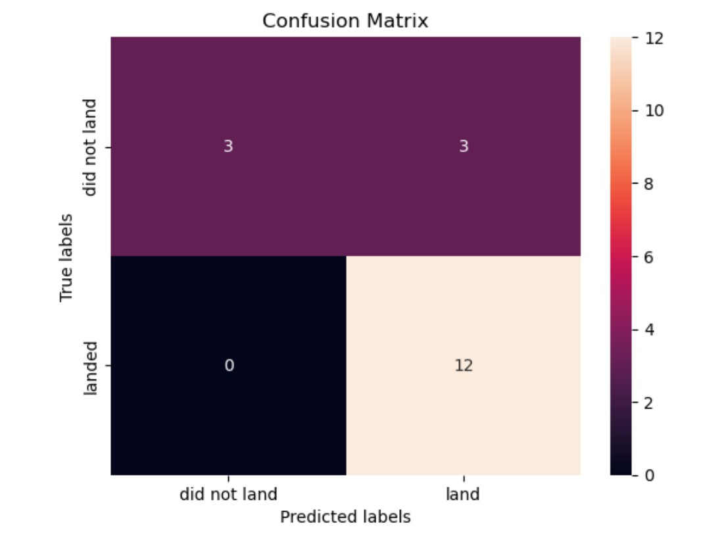
Confusion Matrix
The confusion matrix shows the performance of the Logistic Regression model:
True Positives (landed correctly): 12
True Negatives (did not land correctly): 3
False Positives (incorrectly predicted as landed): 3
False Negatives: 0
Summary:
The model correctly predicts all "landed" instances (no false negatives) but has a slight overestimation with 3 false positives. Overall, it performs well with an 83% accuracy, making it the best-performing model.

Slide 40
Conclusions
Launch Site Insights:
Key launch sites: CCAFS SLC-40, KSC LC-39A, and VAFB SLC-4E.
CCAFS SLC-40 handles the heaviest payloads with consistent success.
Success:
KSC LC-39A achieved the highest success rate at 76.9%.
Model Performance:
Logistic Regression is the best-performing model with an accuracy of 83.3%.
Confusion Matrix:
The model effectively predicts "landed" outcomes with 12 true positives and minimal errors.
Key Insight
The analysis highlights the role of launch sites and payload capacity in mission success, with Logistic Regression providing
reliable predictions for launch outcomes.

